Slide 2
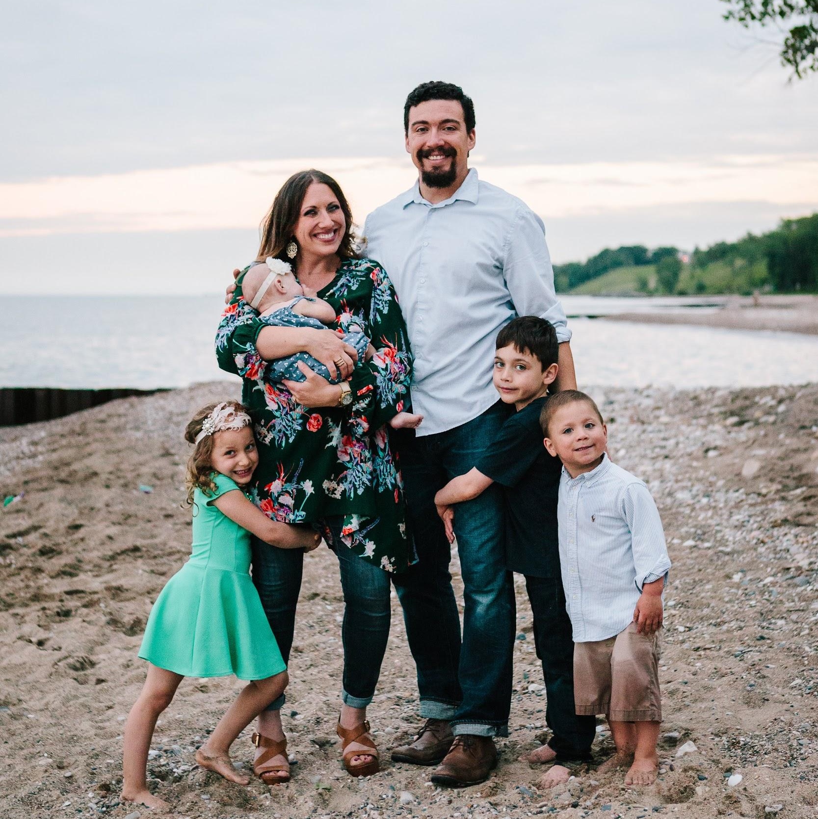
Who am I?
Teacher, speaker, thinker.
Former high school teacher and pastor.
Husband, dad, neighbor.
Most importantly, a follower of Jesus .
joel.settecase@cru.org

Slide 3
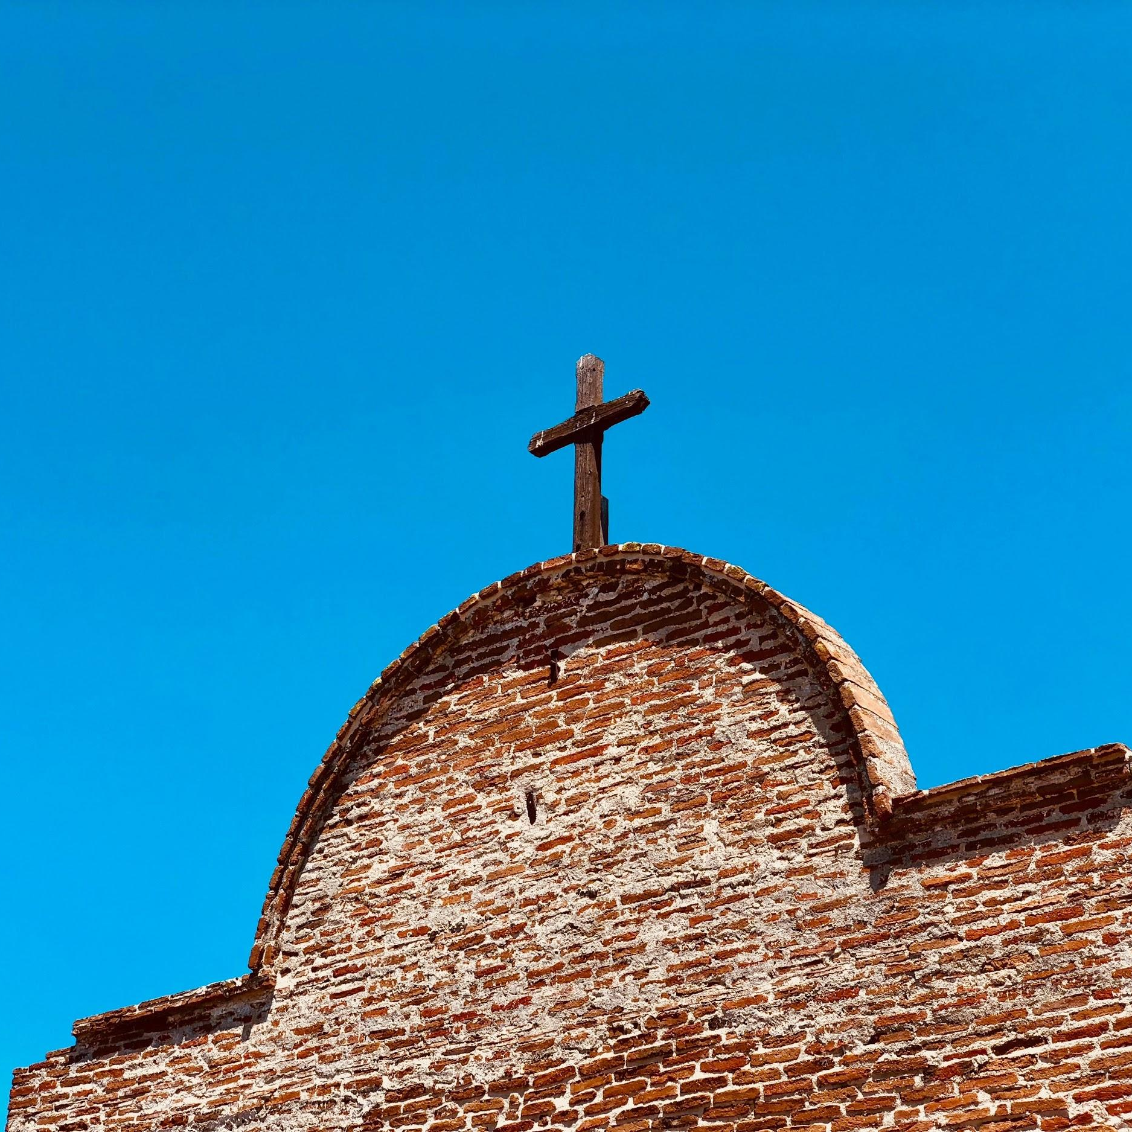
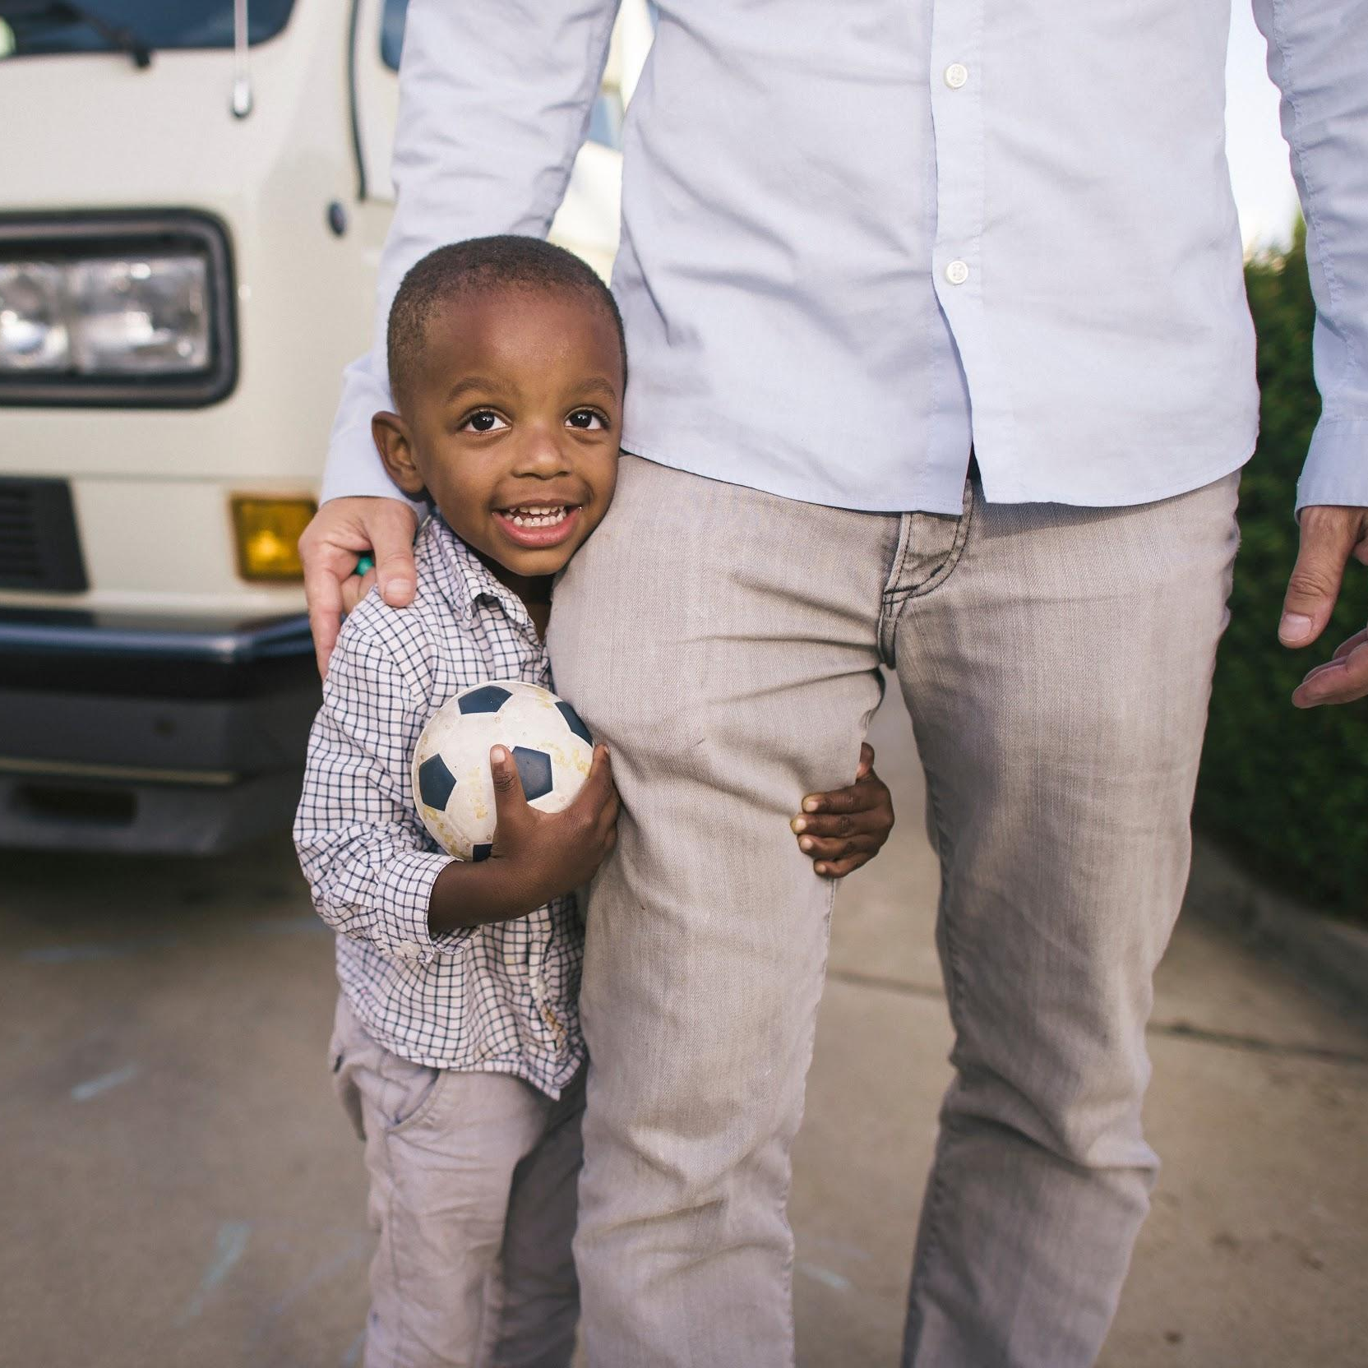
What would you say is the central message of Christianity?
Record your answer.

Slide 4
What is Christianity?
A story.
A religion.
A relationship.

Slide 5
The Story of God
ADAM
IBRAHIM
(ABRAHAM)
MUSA
(MOSES)
DAWUD
(DAVID)
YUNUS
(JONAH)
YAHYA
(JOHN THE BAPTIST)
ISA
(JESUS)
MUHAMMAD

Slide 6
The Story of God
ADAM
IBRAHIM
(ABRAHAM)
MUSA
(MOSES)
DAWUD
(DAVID)
Created good, in God’s image (unity in diversity), for intimacy & to glorify. Fell. Offspring will destroy Satan (Genesis 3:15).
YUNUS
(JONAH)
YAHYA
(JOHN THE BAPTIST)
ISA
(JESUS)
MUHAMMAD

Slide 7
The Story of God
ADAM
IBRAHIM
(ABRAHAM)
MUSA
(MOSES)
DAWUD
(DAVID)
Created good, in God’s image (unity in diversity), for intimacy & to glorify. Fell. Offspring will destroy Satan (Genesis 3:15).
Trusted God, offered his son. given qurban. All nations on earth will be blessed through him & his offspring (Genesis 12:1-3).
YUNUS
(JONAH)
YAHYA
(JOHN THE BAPTIST)
ISA
(JESUS)
MUHAMMAD

Slide 8
The Story of God
ADAM
IBRAHIM
(ABRAHAM)
MUSA
(MOSES)
DAWUD
(DAVID)
Created good, in God’s image (unity in diversity), for intimacy & to glorify. Fell. Offspring will destroy Satan (Genesis 3:15).
Trusted God, offered his son. given qurban. All nations on earth will be blessed through him & his offspring (Genesis 12:1-3).
Lawgiver (Tawrat), liberator (Passover). Law cannot save. Another prophet would come. All God’s people must listen (Deuteronomy 18:15).
YUNUS
(JONAH)
YAHYA
(JOHN THE BAPTIST)
ISA
(JESUS)
MUHAMMAD

Slide 9
The Story of God
ADAM
IBRAHIM
(ABRAHAM)
MUSA
(MOSES)
DAWUD
(DAVID)
Created good, in God’s image (unity in diversity), for intimacy & to glorify. Fell. Offspring will destroy Satan (Genesis 3:15).
Trusted God, offered his son. given qurban. All nations on earth will be blessed through him & his offspring (Genesis 12:1-3).
Lawgiver (Tawrat), liberator (Passover). Law cannot save. Another prophet would come. All God’s people must listen (Deuteronomy 18:15).
Great, conquering king. Poet (Zabur). His descendant will be Lord over all forever and God’s son (2 Samuel 7:12-16; Psalm 2; 110).
YUNUS
(JONAH)
YAHYA
(JOHN THE BAPTIST)
ISA
(JESUS)
MUHAMMAD

Slide 10
The Story of God
ADAM
IBRAHIM
(ABRAHAM)
MUSA
(MOSES)
DAWUD
(DAVID)
Created good, in God’s image (unity in diversity), for intimacy & to glorify. Fell. Offspring will destroy Satan (Genesis 3:15).
Trusted God, offered his son. given qurban. All nations on earth will be blessed through him & his offspring (Genesis 12:1-3).
Lawgiver (Tawrat), liberator (Passover). Law cannot save. Another prophet would come. All God’s people must listen (Deuteronomy 18:15).
Great, conquering king. Poet (Zabur). His descendant will be Lord over all forever and God’s son (2 Samuel 7:12-16; Psalm 2; 110).
YUNUS
(JONAH)
YAHYA
(JOHN THE BAPTIST)
ISA
(JESUS)
MUHAMMAD
God will bury and raise the “Son of Man” after 3 days* to forgive rescue sinners. (Jonah 2:9; Matthew 12:40). *Some say 40; OT says 3.

Slide 11
The Story of God
ADAM
IBRAHIM
(ABRAHAM)
MUSA
(MOSES)
DAWUD
(DAVID)
Created good, in God’s image (unity in diversity), for intimacy & to glorify. Fell. Offspring will destroy Satan (Genesis 3:15).
Trusted God, offered his son. given qurban. All nations on earth will be blessed through him & his offspring (Genesis 12:1-3).
Lawgiver (Tawrat), liberator (Passover). Law cannot save. Another prophet would come. All God’s people must listen (Deuteronomy 18:15).
Great, conquering king. Poet (Zabur). His descendant will be Lord over all forever and God’s son (2 Samuel 7:12-16; Psalm 2; 110).
YUNUS
(JONAH)
YAHYA
(JOHN THE BAPTIST)
ISA
(JESUS)
MUHAMMAD
God will bury and raise the “Son of Man” after 3 days* to forgive rescue sinners. (Jonah 2:9; Matthew 12:40). *Some say 40; OT says 3.
Announced the Messiah, as foretold by Prophet Isaiah. Messiah would forgive the world’s sin by becoming a sacrifice (John 1:29).

Slide 12
The Story of God
ADAM
IBRAHIM
(ABRAHAM)
MUSA
(MOSES)
DAWUD
(DAVID)
Created good, in God’s image (unity in diversity), for intimacy & to glorify. Fell. Offspring will destroy Satan (Genesis 3:15).
Trusted God, offered his son. given qurban. All nations on earth will be blessed through him & his offspring (Genesis 12:1-3).
Lawgiver (Tawrat), liberator (Passover). Law cannot save. Another prophet would come. All God’s people must listen (Deuteronomy 18:15).
Great, conquering king. Poet (Zabur). His descendant will be Lord over all forever and God’s son (2 Samuel 7:12-16; Psalm 2; 110).
YUNUS
(JONAH)
YAHYA
(JOHN THE BAPTIST)
ISA
(JESUS)
MUHAMMAD
God will bury and raise the “Son of Man” after 3 days* to forgive rescue sinners. (Jonah 2:9; Matthew 12:40). *Some say 40; OT says 3.
Announced the Messiah (foretold by Prophet Isaiah). Messiah would forgive the world’s sin by becoming a qurban (“lamb”) (John 1:29).
Messiah. “Word.” Unique birth, teaching, life. Authority & intimacy. Died & rose (Mark 1:27; 10:45). Hated or worshiped (John 20:18).

Slide 13
The Story of God
ADAM
IBRAHIM
(ABRAHAM)
MUSA
(MOSES)
DAWUD
(DAVID)
Created good, in God’s image (unity in diversity), for intimacy & to glorify. Fell. Offspring will destroy Satan (Genesis 3:15).
Trusted God, offered his son. Given qurban. All nations on earth will be blessed through him & his offspring (Genesis 12:1-3).
Lawgiver (Tawrat), liberator (Passover). Law cannot save. Another prophet would come. All God’s people must listen (Deuteronomy 18:15).
Great, conquering king. Poet (Zabur). His descendant will be Lord over all forever and God’s son (2 Samuel 7:12-16; Psalm 2; 110).
YUNUS
(JONAH)
YAHYA
(JOHN THE BAPTIST)
ISA
(JESUS)
MUHAMMAD
God will bury and raise the “Son of Man” after 3 days* to forgive rescue sinners. (Jonah 2:9; Matthew 12:40). *Some say 40; OT says 3.
Announced the Messiah, as foretold by Prophet Isaiah. Messiah would forgive the world’s sin by becoming a sacrifice (John 1:29).
Messiah. “Word.” Unique birth, teaching, life. Authority over world, death. Died & rose (Mark 1:27; 10:45). Hated or worshiped (John 20:18).
600 years after Jesus. Taught Muslims to believe previous Scriptures & follow the signs. These lead to Jesus! (4:136; 7:157).

Slide 14
Biblical Religion
God & Creation
God (Father, Word & Holy Spirit), all-knowing and powerful, created everything good to serve & glorify him. He reveals himself by his works and word.
Man & Fall
Adam sinned when he ate the fruit God said not to eat, bringing pain, death & sin to humanity, who sin and deserve God’s wrath & curse. All have sinned.
Jesus & Redemption
The Tawrat required sacrifice to show our need of forgiveness. God, being Al-Adl (just) cannot overlook sin. The Word came to pay man’s debt and forgive.
Church & Restoration
Christians, live by the power and “fruit” produced by the Holy Spirit and gather to worship, learn and serve. Jesus will return, judge us all by our words and deeds. God’s people will enjoy him forever, while his enemies will be punished.

Slide 15
How to Have a Relationship with God
Confess that Jesus is Lord.
Recognize that all authority in heaven and on earth are his.
Express your true desire to submit your life to him alone.
Receive him, for whom he says he is, and find your hope in him alone.
Romans 10:9-10; Matthew 28:18-20.

Slide 16
How to Have a Relationship with God
Believe in your heart that God raised Jesus from the dead.
Believe he laid down his life for your sins.
Understand this was God’s plan to defeat death and restore your heart to himself.
Believe that God brought Jesus back to life (in other words, believe the Gospel)
Romans 10:9-10; 1 Corinthians 15.:1-7

Slide 17
The Gospel is the Central Message of Christianity.
Jesus the Messiah died according to the Scriptures, was buried, rose according to the Scriptures, now rules, and saves all who trust in him.
Or, “The time is fulfilled, and the kingdom of God has come near. Repent and believe the good news!”
--Jesus’ first khutbah (sermon)

