Slide 2
JOEL SETTECASE
MA, Philosophy of Religion
Christian thinker, writer teacher, speaker, and trainer.
Goal: help believers explain, share and defend the Christian message.
Bringing Christians & non-Christians together for conversation.
Husband to Aliza & father of four awesome kiddos.

Slide 3
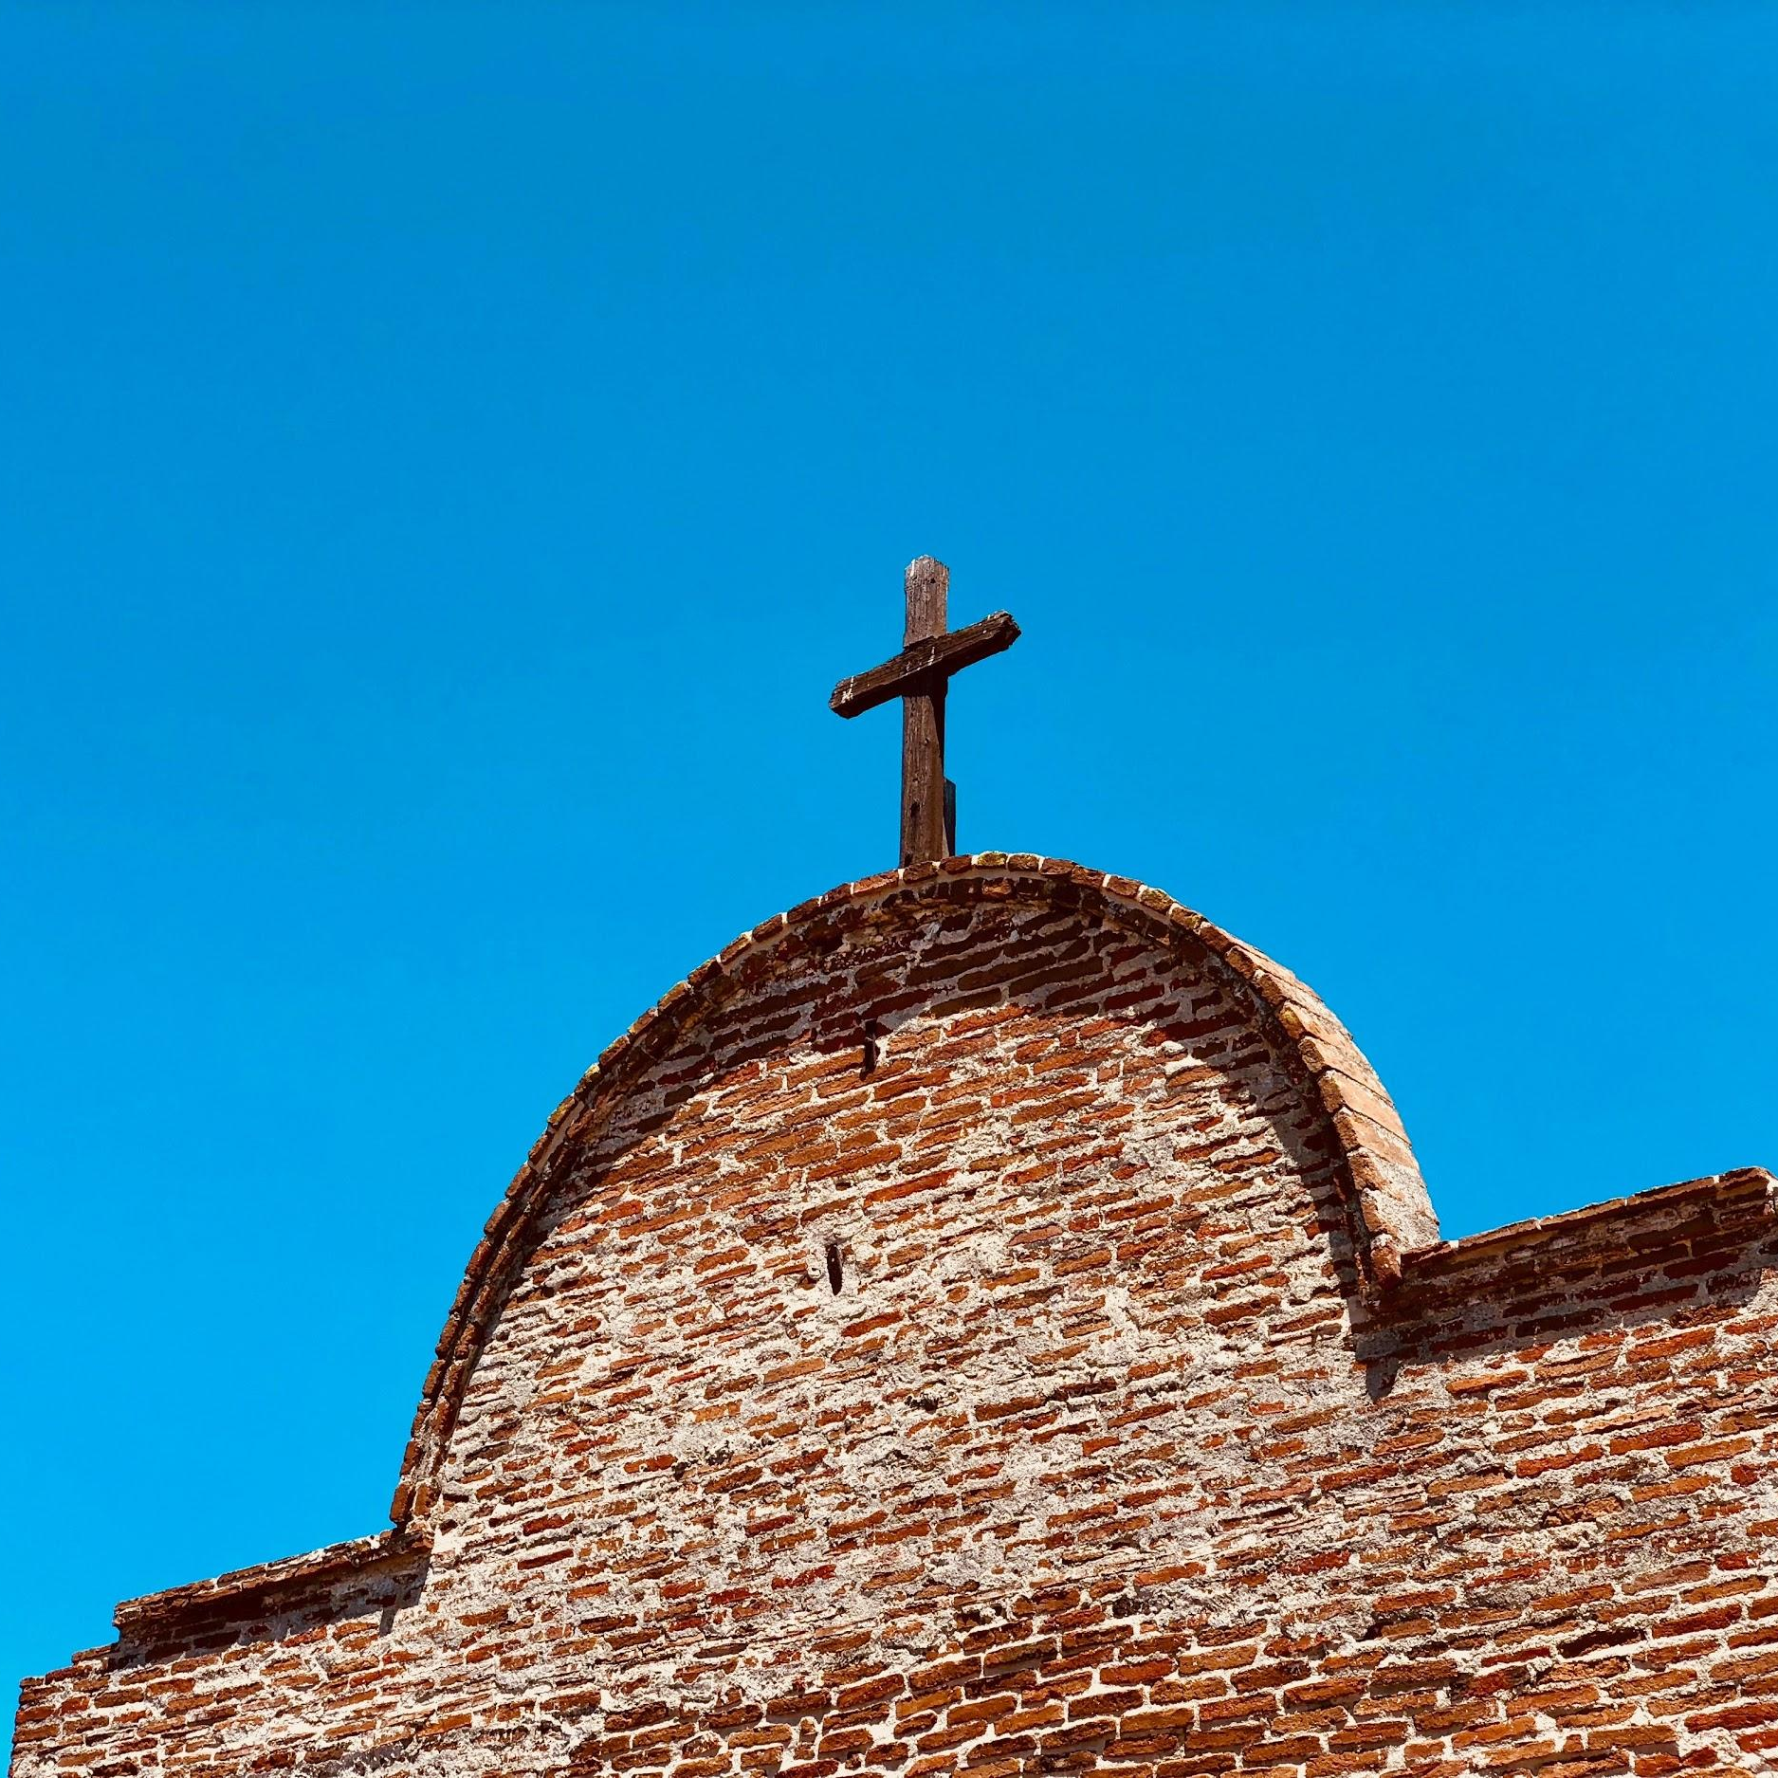
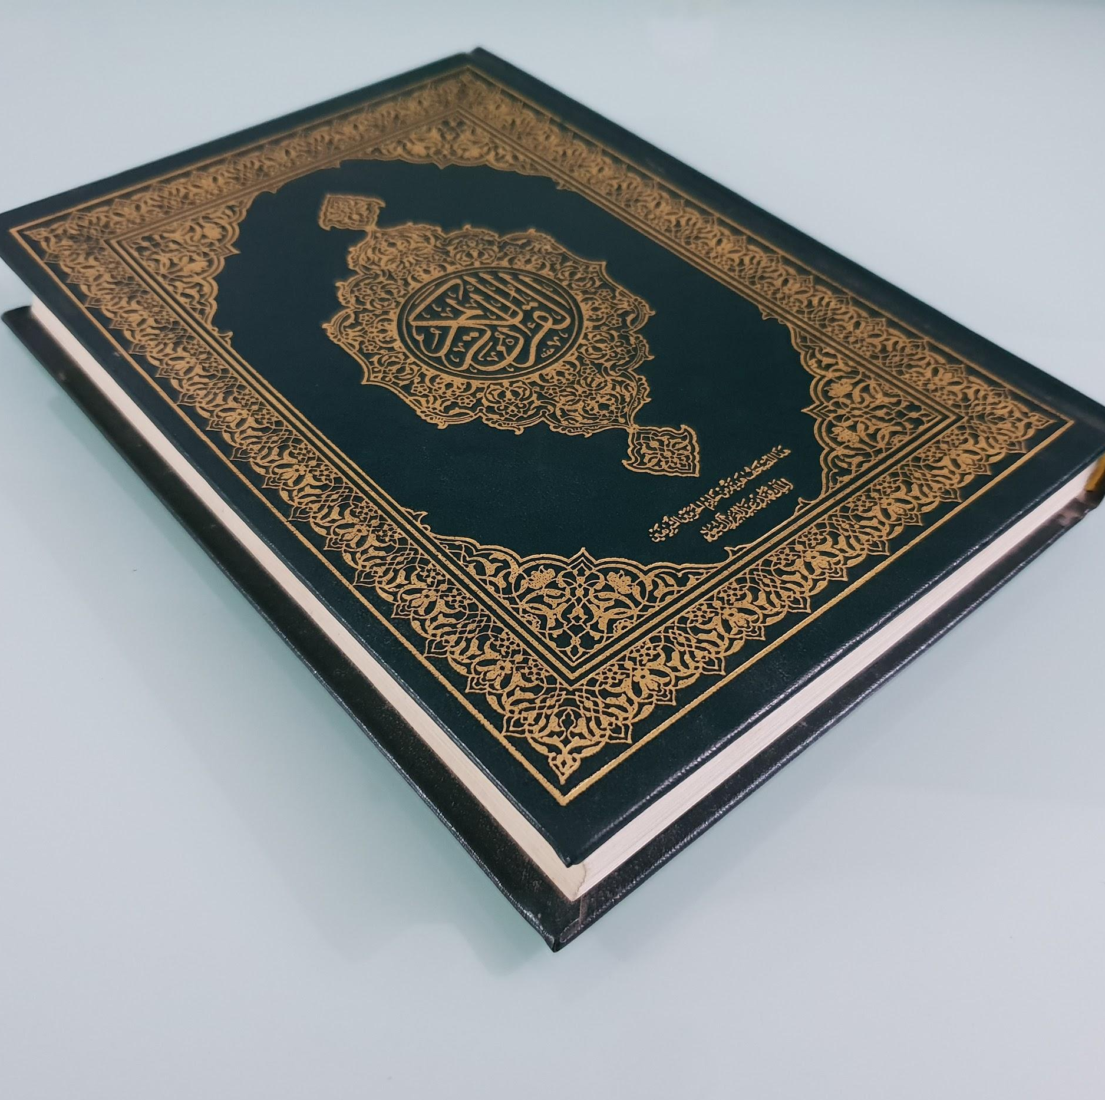
How many similarities and differences can you list between Christianity and Islam?
Record your answer.

Slide 4
Big Idea:
Christian belief and practice is based on the Bible.
And the central message of the Bible is: Jesus the Messiah is Savior and Lord.

Slide 5
We’ll Look At:
Who Is Jesus?
What Christians Believe
What We Do
What Makes Us Christian

Slide 6
Who Is Jesus? (Acts 10:37-42)
“...God anointed Jesus… with the Holy Spirit and with power… he went about doing good and healing… yet they killed him by hanging him on a tree. God raised up this man on the third day and caused him to be seen… he is… appointed by God to be the judge of the living and the dead.”

Slide 7
“He went about doing good and healing”
He turned water into wine.
He healed a royal official’s son.
He healed a paralyzed man.
He walked on water.
He healed a man born blind.
He raised his friend Lazarus from the dead.

Slide 8
“Yet they killed him by hanging him on a tree”
They brought him to the Place of the Skull.
They crucified him between criminals.
Passers-by insulted him.
Darkness fell and he cried out.
The temple curtain was torn.
“Truly this man was the Son of God!”

Slide 9
“God raised up this man... and caused him to be seen”
After an earthquake, two female disciples found an angel at the tomb.
The angel: “He has risen from the dead!”
Jesus met them and told them, “Do not be afraid. Go and tell my brothers….”

Slide 10
Jesus sent out his followers and went up to Heaven
Jesus :“You will receive power when the Holy Spirit has come on you.
He was taken up as they were watching.
Two angels said, “This same Jesus… will come in the same way you have seen him going into heaven.”

Slide 11
The Story of the Lost Son (from Luke 15:11-32)
A man had two sons.
The younger one’s sin
The younger son’s realization
His father’s response
His brother’s response
The meaning of the story

Slide 12
What Christians believe about God
One God, the Lord.
Three persons in the divine nature: Father, Son & Holy Spirit.
Not three Gods.
God has authority, is in control, and is present with his creation.

Slide 13
What Christians believe about Jesus
He is Lord, Messiah, and the Son of God.
Fully God and fully man, yet one person.
Completely perfect.
Equal to the Father, as God. Obedient to God, as man.

Slide 14
What Christians believe about the Good News (Injil)
Problem: “The wages of sin is death.”
Provision: “The free gift of God is eternal life.”
Person: “In Christ Jesus our Lord”

Slide 15
What Christians believe about the Good News (Injil)
If you confess with your mouth, “Jesus is Lord,” and believe in your heart that God raised him from the dead, you will be saved. One believes with the heart, resulting in righteousness, and one confesses with the mouth, resulting in salvation” (Rom. 10:9-10)

Slide 16
Christian Practices: The Church
The “Universal Church” is every believer, worldwide, throughout history.
The “Local Church” is a congregation who gather to worship God, learn God’s word and help each other. Baptized believers who trust in Jesus may join a local church.

Slide 17
Christian Practices: The “Ordinances”
Jesus commanded two rituals: Baptism and Communion (AKA the Lord’s Supper, or the Eucharist).

Slide 18
Christian Practices: Baptism
The first act of outward obedience.
Dunking the believer in water in the name of the Father, Son & Holy Spirit.
The action of going under and coming up symbolizes Jesus’ death & resurrection, our new life, and our future resurrection.

Slide 19
Christian Practices: Communion
An ongoing practice.
Believers eat bread and drink wine/grape juice to remember Jesus’ death for us.
The bread represents his body.
The cup represents his blood.

Slide 20
Christian Practices: Prayer
We pray together and on our own.
There are no set times of prayer. We are taught to “pray without ceasing.”
We pray in Jesus’ name, to Jesus and the Father.
The Holy Spirit helps us pray.

Slide 21
Christian Practices: Fasting
Sometimes we give up food in order to focus on prayer.
We do this without drawing attention to ourselves, as Jesus commanded.

Slide 22
Christian Practices: Worship
We do not have a centralized place of worship for all Christians.
We worship in “Spirit and in truth.”
Believers ourselves, all together, are a living “temple” of God.

Slide 23
Christian Practices: Holidays
Include Christmas (birth of Jesus) and Easter (AKA Resurrection Sunday) (Resurrection of Jesus).
These aren’t commanded, but we are free to celebrate them.

Slide 24
What Makes Us Christian?
There are many streams of Christianity and many groups who claim to be Christian.
True Christian faith is in what the Bible teaches about God, Jesus & the Gospel.
Salvation by grace alone, through faith alone, by Christ alone, based on the Bible alone.

Slide 25
Want to learn more?
Go to TheThink.Institute.
Thanks for listening!
Q&A Time

